Slide 1
Driver Drowsiness Monitoring System using Visual Behavior
PROJECT D TEAM PAVAN SARAN KUMAR Pamidimarri - 16330824 DEEPAK KUMAR CHADA - 16338496 DHANUNJAYA LAKSHMAN KONERu - 16336828
SREELEKHA INDARAPU - 16322036

Slide 2
Abstract :
The purpose of this project is to detect the drowsiness in the face of the drivers thereby to prevent accidents.
This project is a safety technology that helps to prevent accidents that are caused when the drivers fell asleep while driving.
It works based on the facial features such as eye blinks, head movements and yawning.
The main objective of this project is to build a drowsiness detection system that will detect the eyes of the driver and alert him with an alarm sound if his eyes are closed for few seconds while driving.

Slide 3
Introduction :
The aim of this project is to develop a prototype drowsiness detection system.
The focus is on designing a system that will accurately monitor the open or closed state of the driver’s eyes in real-time.
A method for detecting drowsiness in drivers is developed by using a camera that point directly towards the drivers face and capture for the real time image.
Once the image is captured, monitoring the face region and eyes in order to detect drowsiness

Slide 4
Requirements :
Webcam to capture images of the driver
Python
Opencv : It is an open source library for computer vision and image processing tasks in machine learning.
Tkinter: It is a python binding to the Tk GUI tool kit
Dlib : Toolkit for making real world machine learning and data analysis applications using C++
Playsound : we used it to produce the alarm or alert sound.

Slide 5
Modules :
Open cv
TKinter
Dlib
PIP allows you to install and manage packages that are not part of the python standard library
We have used opencv library for face and eye detection, tkinter to build our GUI model, dlib for analysis and finally play sound to play alarm sound.

Slide 6
Algorithm :
Step1 - Take image as input from a camera.
Step 2 – Detect the face in the image and create a Region of Interest (ROI).
Step 3 – Detect the eyes from ROI and feed it to the classifier
Step 4 – Classifier will categorize whether eyes are open or closed
Step 5 – check whether the person is drowsy

Slide 7
Flow chart :
We have a simple flowchart showing how this system works,
Starting with image captured by the webcam taken as input
ROI is nothing but Region of interest that is driver’s eyes then eyes are detected
IF there is a decision making statement if the eyes are open then we have no issues. Retakes the image as input and repeats the process from start
ELSE IF the driver’s eye is closed this is where our detection system detects the drowsiness calculates the drowsiness based on his eyes and gives him a message. if the driver yawns, it gives an alert, else it means the driver is enough active to drive and starts the process from start from taking input as image.

Slide 8
Files:
The driver drowsiness folder contains our model file sound.wav file that consists of an audio clip which is played when the drives feels drowsy.
drowsinessdetector.py file contains the program from which we built the model using SVM classifier. We can also see run.bat is the main file of our project, to start our process we have to run this file.

Slide 9
Import Functions:
Import functions are used to get access the code in a module from another module by the process of importing it. The code which we importing might be from user defined library or from built in libraries.
Tkinter and Imutils, dlib, cv2, numpy are the different libraries that we used in this project.

Slide 10
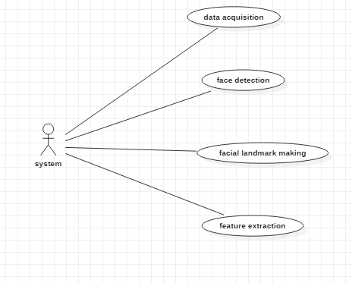
UML diagram

Slide 11
Class diagram

Slide 12
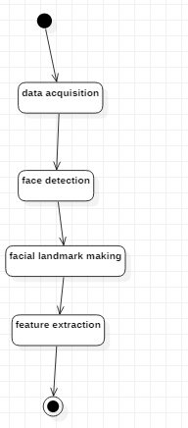
Activity diagram

Slide 13
Hardware & SOFTWARE requirements
Operating System supported by
Windows 7
Windows XP
Windows 8
Processor - Pentium IV or higher
RAM - 256 MB
Space on Hard Disk - Minimum 512 MB
Software used to build application - Python

Slide 14
MODULES
Data Acquisition
Face Detection
Facial Landmark marking
Feature Extraction
Classification

Slide 15
Data aCquisition
The video is recorded using webcam (Sony CMU-BR300) and the frames are extracted and processed in a laptop.
After extracting the frames, image processing techniques are applied on these 2D images. Presently, synthetic driver data has been generated. The volunteers are asked to look at the webcam with intermittent eye blinking, eye closing, yawning and head bending. The video is captured for 30 minutes duration

Slide 16
Face detection
After extracting the frames, first the human faces are detected. Numerous online face detection algorithms are there. In this study, histogram of oriented gradients (HOG) and linear SVM method is used.
In this method, positive samples of descriptors are computed on them. Subsequently, negative samples (samples that do not contain the required object to be detected i.e., human face here) of same size are taken and HOG descriptors are calculated.
Usually the number of negative samples is very greater than number of positive samples. After obtaining the features for both the classes, a linear SVM is trained for the classification task. To improve the accuracy of VM, hard negative mining is used. In this method, after training, the classifier is tested on the labeled data and the false positive sample feature values are used again for training.

Slide 17
Facial Landmark marking
After detecting the face, the next task is to find the locations of different facial features like the corners of the eyes and mouth, the tip of the nose and so on. Prior to that, the face images should be normalized in order to reduce the effect of distance from the camera, non-uniform illumination and varying image resolution.
Therefore, the face image is resized to a width of 500 pixels and converted to grayscale image. After image normalization, ensemble of regression trees is used to estimate the landmark positions on face from a sparse subset of pixel intensities. In this method, the sum of square error loss is optimized using gradient boosting learning. Different priors are used to find different structures. Using this method, the boundary points of eyes, mouth and the central line of the nose are marked and the number of points for eye, mouth and nose. The red points are the detected landmarks for further processing.

Slide 18
Feature Extraction
After detecting the facial landmarks, the features are computed as described below. Eye aspect ratio (EAR): From the eye corner points, the eye aspect ratio is calculated as the ratio of height and width of the eye

Slide 19
CLassification
As the size of eye can vary from person to person, this initial setup for each person will reduce this effect. Similarly, for calculating threshold of MOR, since the mouth may not be open to its maximum in initial frames (setup phase) so the threshold is taken experimentally from the observations. If the test value is greater than this threshold then yawn (i.e., drowsiness) is detected.
Head bending feature is used to find the angle made by head with respect to vertical axis in terms of ratio of projected nose lengths. Normally, NLR has values rom 0.9 to 1.1 for normal upright position of head and it increases or decreases when head bends down or up in the state of drowsiness. The average nose length is computed as the average of the nose lengths in the setup phase assuming that no head bending is there. After computing the threshold values, the system is used for testing.
The system detects the drowsiness if in a test frame drowsiness is detected for at least one feature.

Slide 20
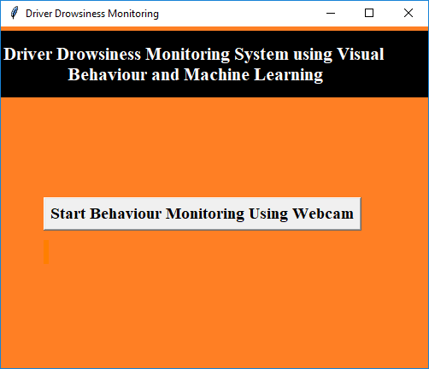
EXECUTION
To run this project, double click on ‘run.bat’ file to get below screen

Slide 21
Step 1
Click on ‘Start Behaviour Monitoring Using Webcam’ button to connect application with the webcam, after clicking button we get web cam streaming.

Slide 22
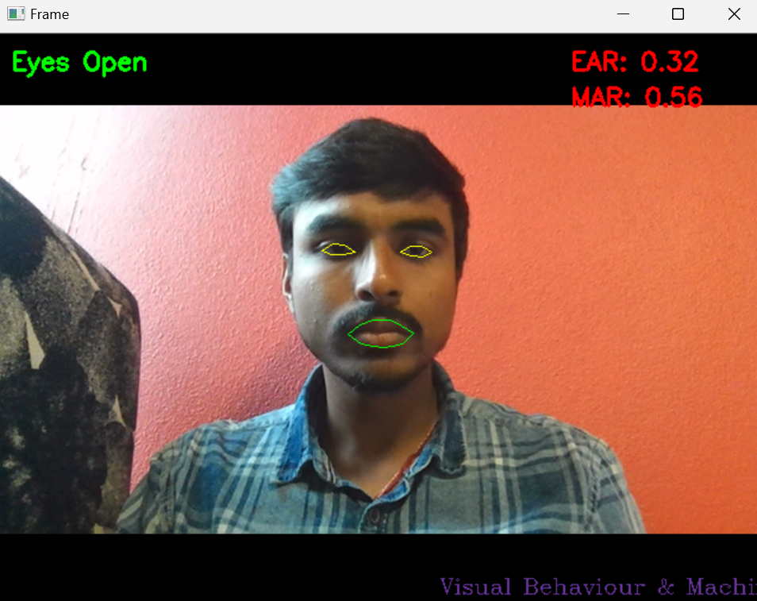

Slide 23
Step 2 :
Application monitors all frames to see person’s eyes are open or not, if closed we get below message
Eyes closed – EAR , MAR

Slide 24
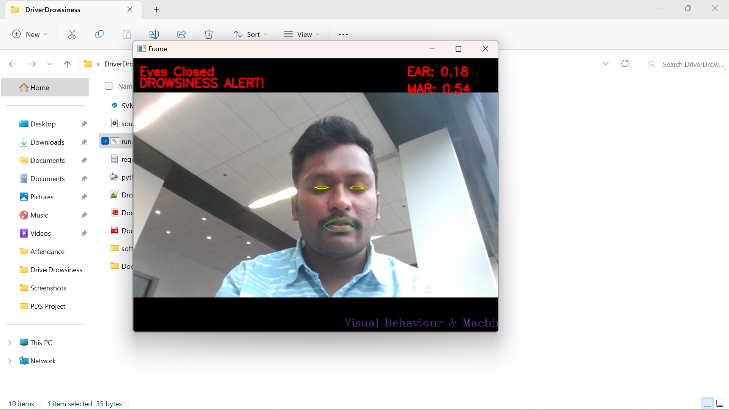

Slide 25
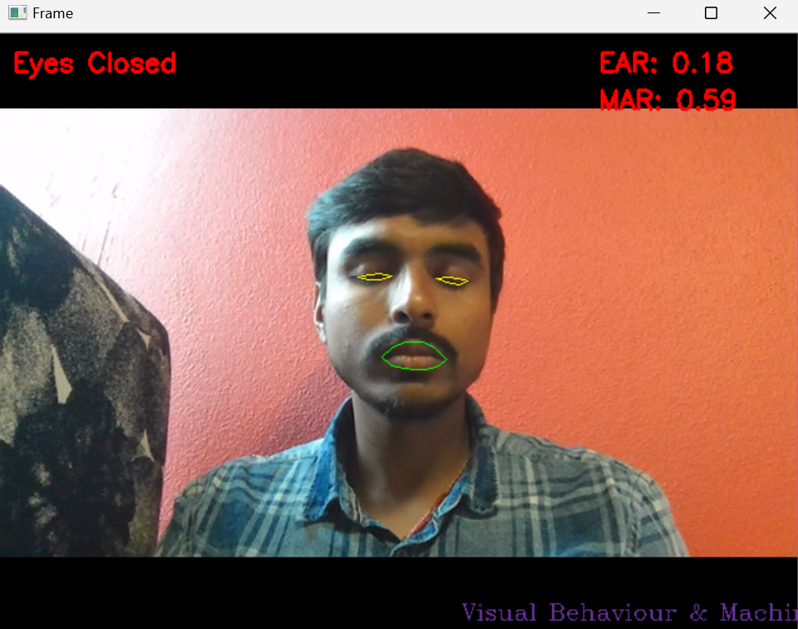

Slide 26
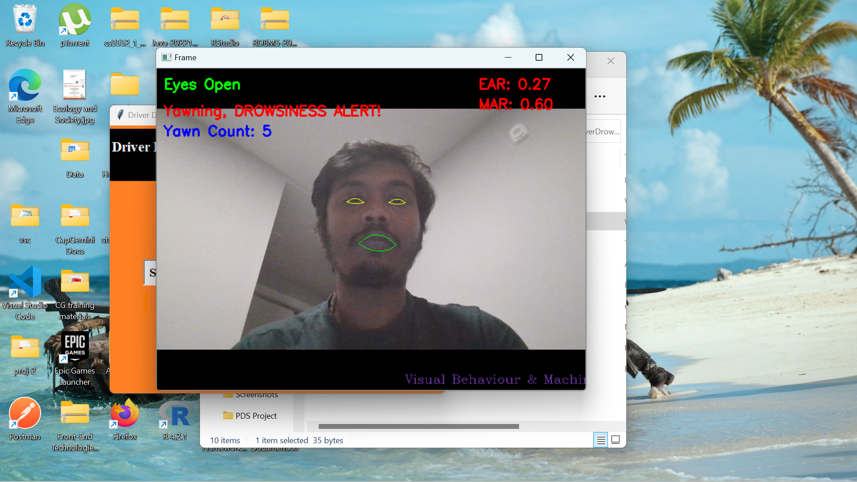
Step 3 :
Similarly, if mouth starts yawn then we get an alert message as shown below

Slide 27
conclusion
In this project, a low cost, real time driver drowsiness monitoring system has been proposed based on visual behavior and machine learning. Here, visual behavior features like eye aspect ratio, mouth opening ratio and nose length ratio are computed from the streaming video, captured by a webcam.
An adaptive thresholding technique has been developed to detect driver drowsiness in real time. Also, the system will be implemented in hardware to make it portable for car system and pilot study on drivers will be carried out to validate the developed system.

